Slide 1
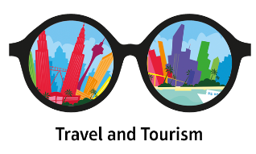
BTEC Level 2
TRAVEL AND TOURISM
Applied GCSE

Slide 2
What is TRAVEL AND TOURISM?
Travel and Tourism is a course designed to give you an understanding of the fasting growing Employment sector in the Economy
Travel and Tourism can give you life skill which may help you to have a Career in the Travel and Tourism sector in the Future

Slide 3

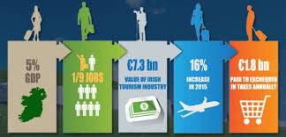
Are there Opportunities in Travel and Tourism?

Slide 4
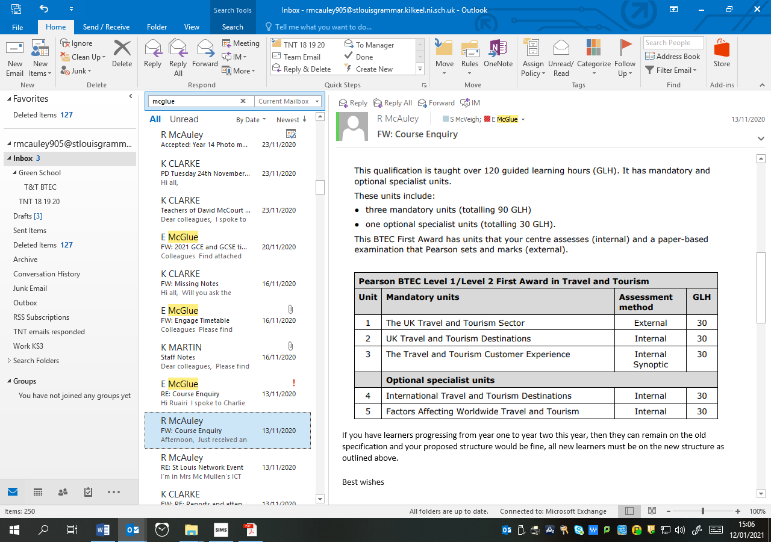
What does the course involve?

Slide 5
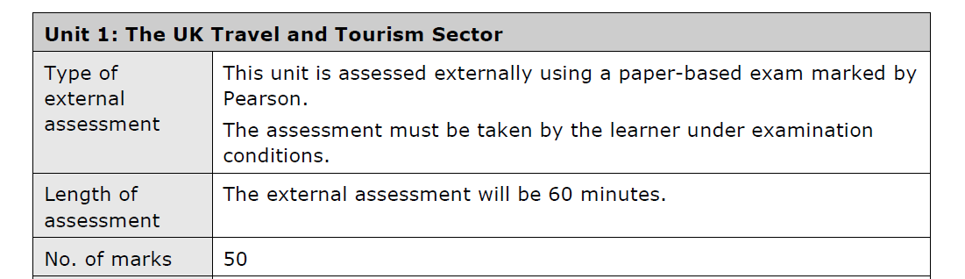

The UK Travel and Tourism Sector
One Exam Unit
Assessment Availability; January and June
First Assessment Date; January 2025

Slide 6
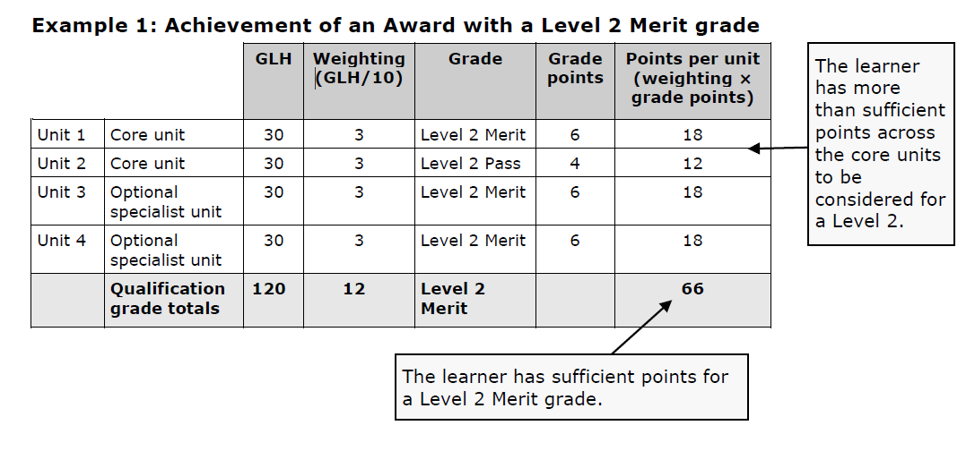
Marking is Merit and Distinction
Awarded as:
Merit
Or
Distinction

Slide 7
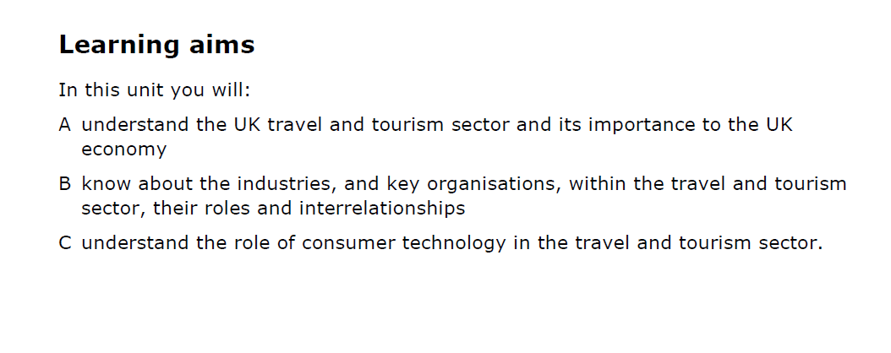
Unit 1 (External Examination)

Slide 8
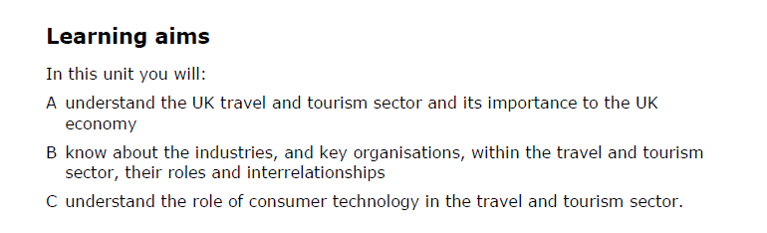
Unit 2
(Coursework Unit - Internally Assessed/Externally moderated)

Slide 9
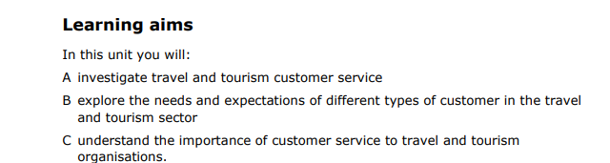
Unit 3
(Coursework Unit - Internally Assessed/Externally moderated)

Slide 10
Unit 4 and 5 are “Optional Units”
(Coursework Unit - Internally Assessed/Externally moderated)
*At St. Louis we opt for Unit 4; International Travel and Tourism Destinations

Slide 11
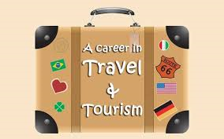
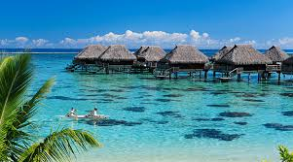
What are the Career options
Waitress Lifeguard
Ski Instructor Accountant
Tour Bus Driver Tour Guides
Hotel Assistant Swimming Coach
Ferry Drivers Shop Assistants
Ranger for National Park Surf Instructor
Driver Restaurant Worker
Pilot Travel Agent
Hotel Manager Transport Manager
Translator Event Coordinator
Theme Park Operator

Slide 12


Organisations Involved in Travel and Tourism

Slide 13
In Order to be accepted to Study Travel and Tourism you must be recommended by your Geography Teacher

Slide 14
Find out more from this video on Youtube
https://www.youtube.com/watch?v=rcJHfSrCZg8

